Slide 1
Understanding Creative Coding characteristics:
a large-scale scraping and analysis of open-source projects
Candidate
Shantal - Marie Fabri Genskowsky
Supervisors
Luigi De Russis
Juan Pablo Saenz Moreno

Slide 2
What is creative coding
Application of computer programming where the goal is to create something expressive or artistic.
Results not necessarily predefined and rather based on discovery, variation and exploration that can produce unexpected results.
The growth in its popularity and applicability makes it a relevant and very interesting field to look at, analyze and learn more about.
Its existence also goes to show the capabilities of computers, beyond functional purposes.
Waltz of the Circles by MiniPear
Notes:
Creative coding is an application of computer programming where the goal is to create something expressive or artistic. Through the use of software, code and computational processes, it aims to create results that are not necessarily predefined and rather based on discovery, variation and exploration that can sometimes produce unexpected results.
The growth in its popularity and applicability makes creative coding a relevant and very interesting field to look at, analyze and learn more about. And, moreover, its existence also goes to show the capabilities of computers that go beyond functional purposes.

Slide 3
Goal
The goal of this thesis is to better understand the state of the art and the current way creative coding is being done, and then evaluate how well the creators of these projects are programming.
Understand and characterize how it is that creators are coding, what programming languages they are using, how they are structuring their code, find common patterns.
Evaluate measurements like lines of code (LOC), amount of files per project, complexity of projects as a whole and of functions, variation of functions, and other maintainability and complexity indexes.
Notes:
The goal of this thesis is to better understand the state of the art and the current way creative coding is being done. The objective is to understand and characterize what it is that creators are doing and how they are creating, what programming languages they are using, how they are structuring their code and projects, see if there are common patterns between different creative coding projects, what these patterns are and how many share them, etc. After this analysis, the goal is to evaluate how well these creators are programming based on measurements like lines of code (LOC), lines of comments, amount of files per project, complexity of projects as a whole and of functions, parameters used in functions, variation of functions, and other maintainability and complexity indexes.

Slide 4
Process and Steps
Web Scraping
Data Collection
Analysis
Conclusions

Slide 5
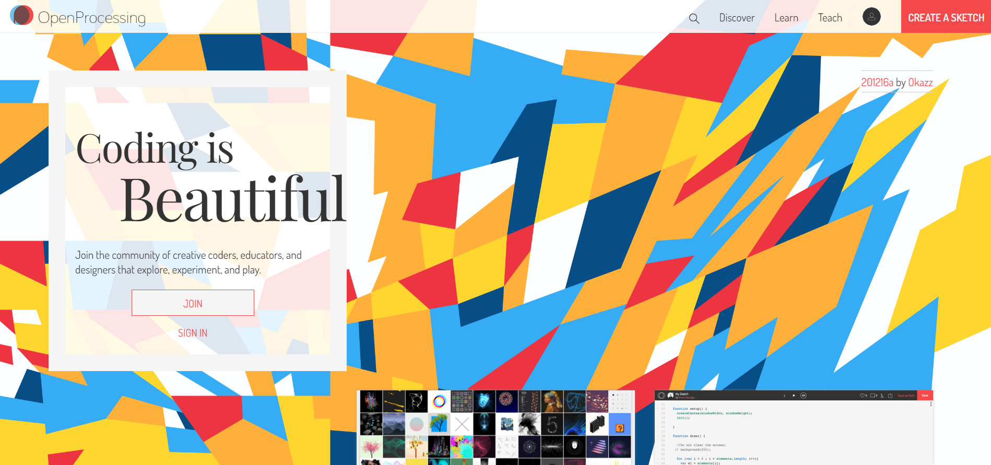
OpenProcessing
Creators publish their creative coding projects online, many in open source platforms.
One of the main platforms is the website OpenProcessing (https://openprocessing.org/), that hosts over one million projects.
Encourages collaboration within the community. Projects can be shared, downloaded, liked, commented and forked to create the base for a new project to build on.
Main page of OpenProcessing
Notes:
Nowadays, creators publish and share their creative coding projects online. A lot of creators publish and share their creative coding projects on open source platforms. One of the main platforms where this is done is \emph{OpenProcessing}, a website that hosts over one million projects and invites creative coders, educators and designers to explore, experiment and play, and where creators can share their projects as open source and collaborate with the community. Each project can be shared, downloaded, liked and commented on by other users of the website, who can also fork the projects to further work on them or add their own twists to what other creators have done.
explain that its like the github to upload

Slide 6
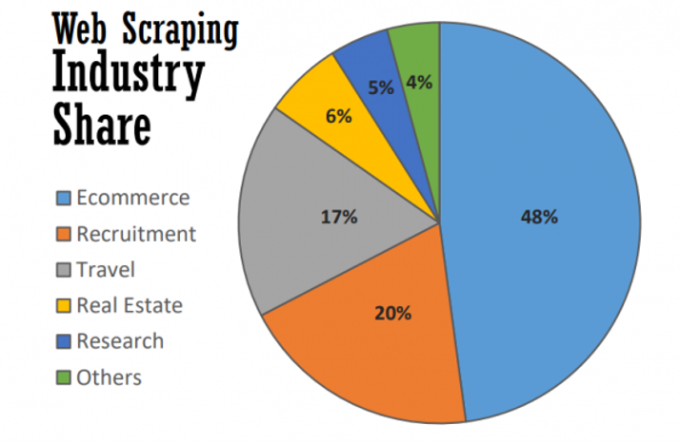
Web Scraping
Practice of extracting or “scraping” data from the web. The term usually refers to the use of automation tools to collect the data.
Form of gathering and copying data from the web, into a local or central database where it can later be retrieved from or analyzed.
Many applications, like news and content scraping, research, price comparison, etc. and many sectors that use it, such as real estate, travel agency, e-commerce, among others.
Notes:
Web scraping, or scraping for short, is the practice of extracting or “scraping” data from the web. Even though web scraping can be done manually, the term usually refers to the use of automation tools to collect data from the web, be it a software script that simulates a human’s interaction with the website, a browser extension or a different tool. It essentially is a form of gathering and copying data from the web, into a local or central database where it can later be retrieved from or analyzed.
The applications of web scraping reach a big range of sectors with many different purposes. The different sectors that consume web data go from real estate, travel agencies, recruitment firms to research, e-commerce industry being the biggest consumer. The uses for web scraping include, news and other content scraping, contact scraping, research, price comparison, market study, brand monitoring, website change detection, among others.

Slide 7
Scraping in this thesis
The scraping for this thesis was done over OpenProcessing, with a script to simulate a person navigating the website. This script was written in python with the help of the library Selenium.
Needed to obtain the source code of almost 30000 creative coding projects, divided in hearted and created subgroups.
Executed in two phases, link collection and downloading of projects.
Notes:
The scraping, as mentioned before, was done over the website OpenProcessing, with a script that works directly on a web browser and simulates what a person would do while navigating the site. In this case, the script was written in the programming language python and the library Selenium was used to perform the different actions on the website and everything related to the scraping itself, and it was programmed to run on an instance of the web browser Firefox.
2 phases – link collection and project downloading

Slide 8
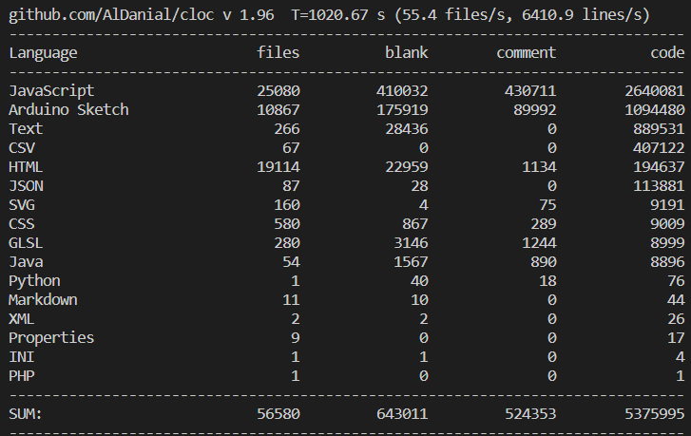
Data collection with Count Lines of Code (CLoC): files and languages
Command line program that takes files, directory or archive names as inputs, on which it then counts blank lines, comment lines and physical lines of code.
Categorizes files into languages/types, giving information for each one. This was used to get an aggregated overview of what creators are using (languages and other files) and to recognize broad patterns among sketches.
Example output of CLoC
Notes:
CLOC
– counts files and categorizes them in languages/filetype
– counts lines of code and comments

Slide 9
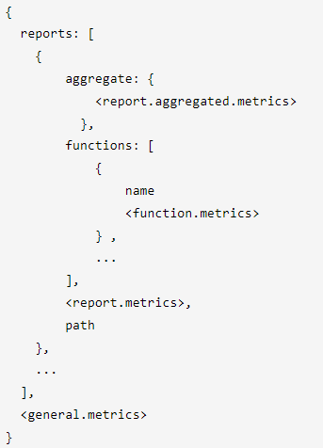
Data collection with Complexity Report (CR): various metrics
Node.js based tool that reads files and produces as output a tree-like report for files and its functions.
The report includes metrics like lines of code, number of parameters, cyclomatic complexity, cyclomatic complexity density, halstead metrics and maintainability index, for both files and functions when applicable.
Used to analyze the JavaScript files present in the sketches.
The produced results were further analyzed, grouped, categorized and worked on with python and jupyter notebook.
Format of CR report output
Notes:
CR - Complexity report
– for JS
– looks into files, gives many metrics
lines of code, number of parameters, cyclomatic complexity, cyclomatic complexity density, halstead metrics, maintainability index
– looks into funcs in files
complexity-report is just a node.js-based command-line wrapper around escomplex, which is the library that performs the actual analysis work. Code is passed to escomplex in the form of syntax trees that have been generated with esprima, the popular JavaScript parser.

Slide 10
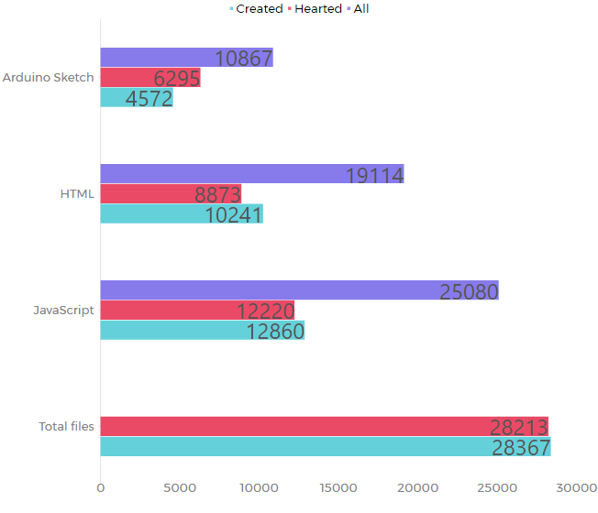
Analysis of CLoC results
JavaScript, HTML and Arduino Sketch (Processing), together about 97% of all files.
JavaScript files about 44% of all files, HTML about 34% and Arduino Sketch about 20%.
JS based sketches come paired with an HTML file that renders the sketch, the percentages are similar. Using this as an estimate of JS based sketches, about 1/3 of sketches are Processing based, while about 2/3 are JavaScript based.
For hearted sketches, higher counts and averages of lines of code and comments. And slightly higher use of external files.
Notes:
the three most common languages that appeared were JavaScript, HTML and Arduino Sketch (Processing), together corresponding to about 97% of all files. That other 3%, corresponding mainly to media and stylesheet type files, was immediately deemed as not worth for analysis, given the types of files and neglectable quantity.
Using HTML files as an approximate of number of JS based sketches, and number of Arduino Sketch files as approximate for Processing sketches, about 38% of all sketches correspond to pde based projects, while about 66% of all sketches correspond to JavaScript based projects.

Slide 11
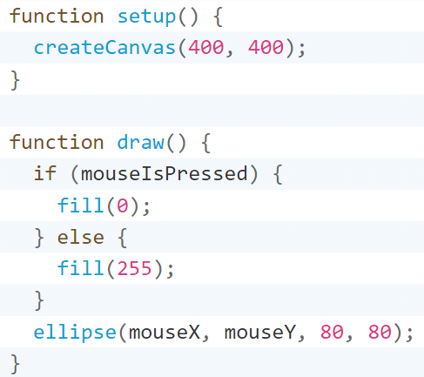
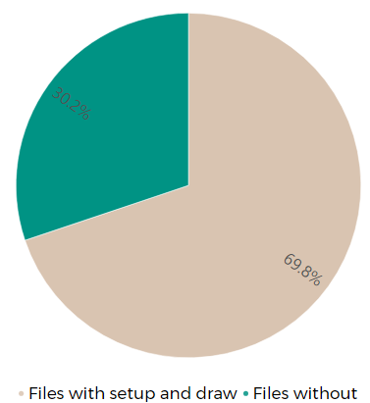
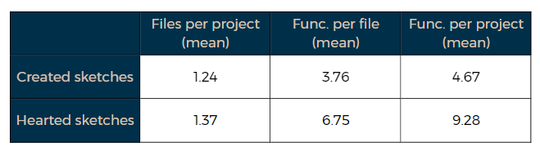
Analysis of CR results: functions and files
JavaScript based sketches formed by at least one JS file, commonly named mySketch.js.
The base of the sketches is the functions setup and draw, defined by the p5.js library, with almost 70% of files analyzed containing both functions.
In general, functions take no parameters.
Higher amount of functions per file and per project was observed in hearted sketches. And a higher rate of files per project on average on hearted sketches.
Notes:
base of a JS sketch is funcs setup and draw — 69.84% files with setup and draw
In the case of hearted sketches, when compared with the created subgroup of sketches, a higher percentage of functions per file and per project was observed.
They also presented a higher rate of files per project on average. Both of these observations can implicate a higher modularization, both of components of sketches and functions in general, and also possible a higher complexity of the sketches developed.

Slide 12
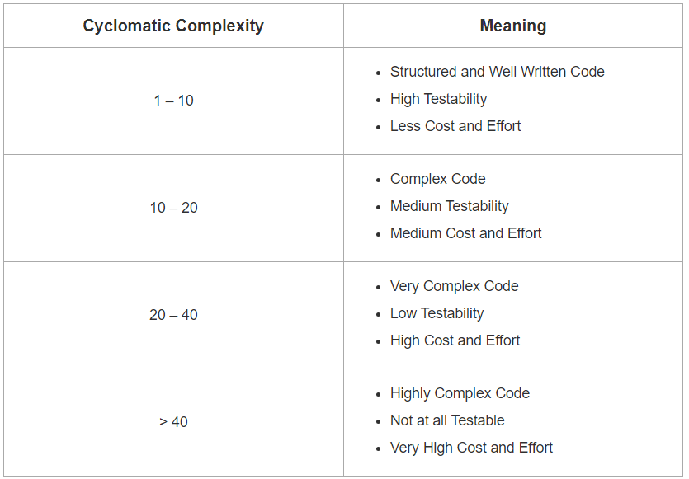
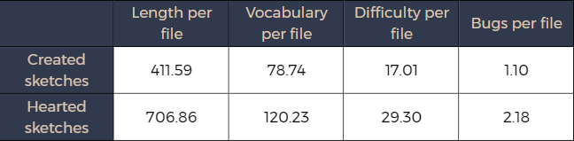
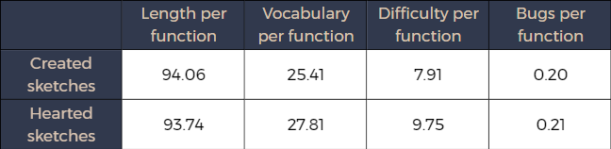
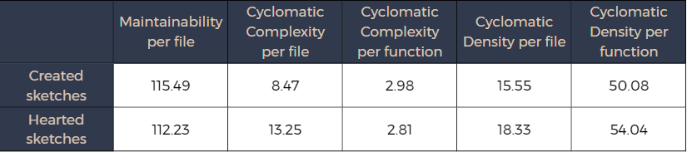
Analysis of CR results: metrics
Statistics and values similar across both subgroups, especially at function level, with hearted sketches showing on average slightly higher values on metrics related to complexity.
The data showed on average what is considered as good and acceptable ranges.
Complexity related metrics showed low values, whereas maintainability metrics showed a tendency for high values, relative to this metrics range: ]-inf, 171]
Creators in general have code that is maintainable, readable, manageable and not too complex.
Notes:
among all subgroups of sketches, the statistics and values obtained showed to be very similar. In the case of the hearted subgroup of sketches, they showed, on average, slightly higher values on metrics related to complexity, which goes along with the results and conclusions mentioned in slide before.
(below 20 for cyclomatic complexity, considered complex but readable and even below 10, considered well written code),
When it came to the values of the metrics themselves, all the data showed on average what would be considered as “good and acceptable ranges”. With the exception of a few records that ‘escaped’ the tendencies of all other records, for complexity related metrics, the values were on average low, and in the case of maintainability indexes sketches showed values tending to the higher segment of the range. All this implies that creators in general have code that is maintainable, readable, manageable and not too complex.

Slide 13
Conclusions
JavaScript with the library p5.js seems to be the leading way over Processing.
At source code level, these projects seem to have a very similar structure and characteristics, but the results are very dynamic and diverse, many requiring user interaction.
Hard to discern and identify what makes a good sketch good.
Using hearted/created division to determine “good” sketches, better, more modularized but also more complex code, leads to more appealing sketches.
perlin noise by yasai
Notes:
JS + p5.js seems to be the leading way for programming – very accessible
It is important to notice, that even though at source code level, these projects seem to have a very similar structure and characteristics, the results are very dynamic and diverse, and many of them involve the interaction of the user to actually create a meaningful result. For this reason, it is very hard to discern and actually identify what makes a good sketch good by just looking at the code alone. In general, it's hard to obtain many concrete conclusions without also analyzing visually what the result of these projects is
The only differentiation in use was the division of sketches into hearted sketches and created or recent sketches. When using this as a factor to determine ‘good’ sketches, it seems that better, more modularized but at the same time more complex code, seems to lead to more appealing sketches that are more liked by the community.

Slide 14
Further opportunity of research
Include more data about popularity and visual results of sketches rather than just the source code and division into hearted and created sketches.
Analyze Processing based projects.
Research on the use of external files (not JavaScript, HTML or Processing). What they contribute to sketches and why they aren't currently used.
Notes:
For further opportunity of research:
The problem that only having the source code of projects without the output of it could present an opportunity for further research in the future, where more data about the popularity and visual results of the sketches is considered.
For the case of this thesis, it was deemed that only the JavaScript files were worth looking at and analyzing in detail, leaving the Processing sketches out of the research, since, besides the great difference in quantity, there were no tools found that could analyze this language for the factors desired. This could also be an opportunity for further future research, along with the creation of a tool to analyze this language.
Finally, a possible area to further investigate is the use of external files (not JavaScript, HTML or Processing). The functions and uses of these could be investigated, how they can help the creation of better creative coding projects and why they are currently not being used much. Furthermore, from that investigation, tools to help creators take advantage of these types of files could be created and developed.

